Slide 1
Post Christmas meeting IV.
06/03/2023

Slide 2
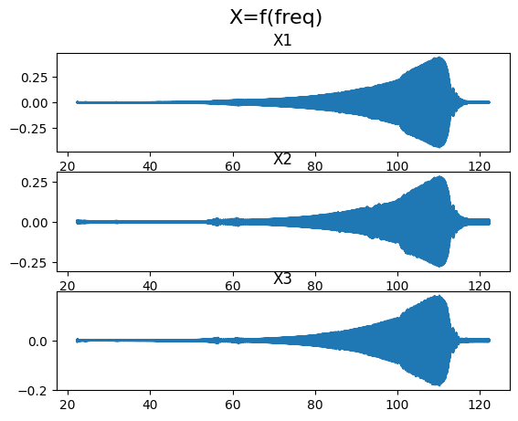
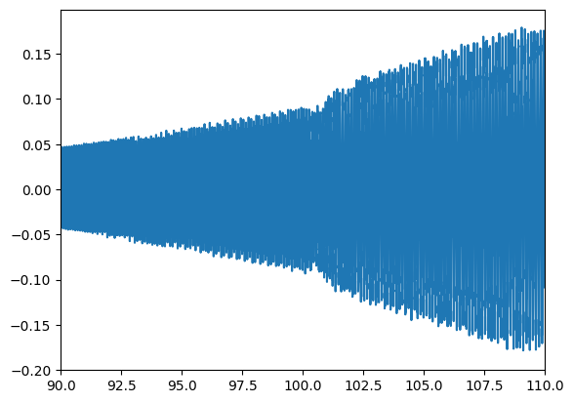
F=100, r=1,15 dampcoef=0,01

Slide 3
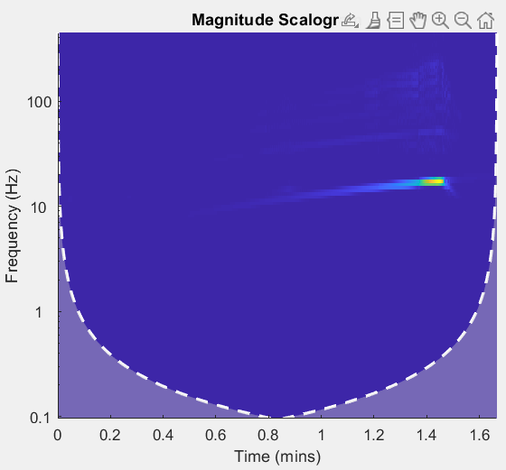

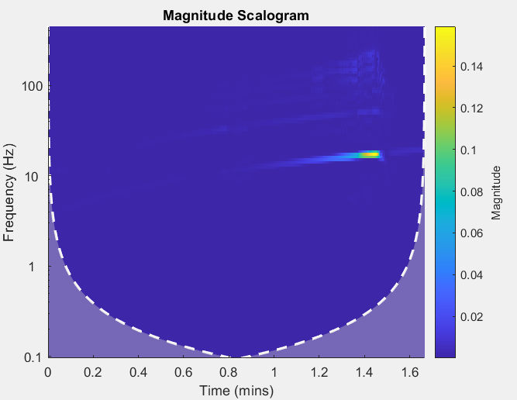
Wavelet transforms
X₁
X₂
X₃

Slide 4
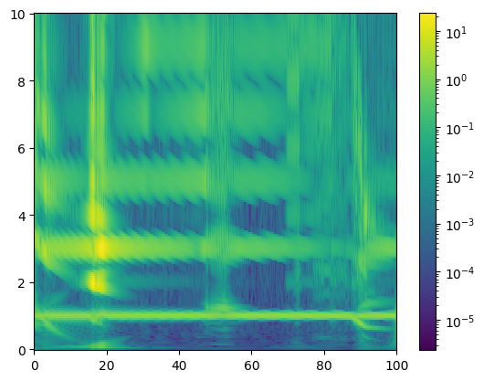
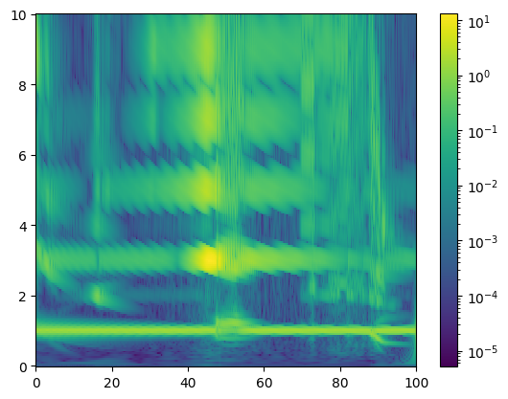
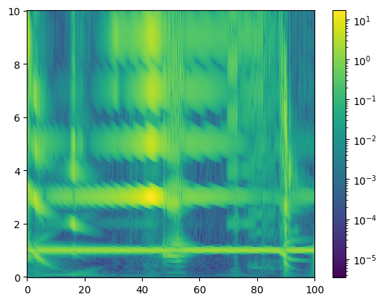
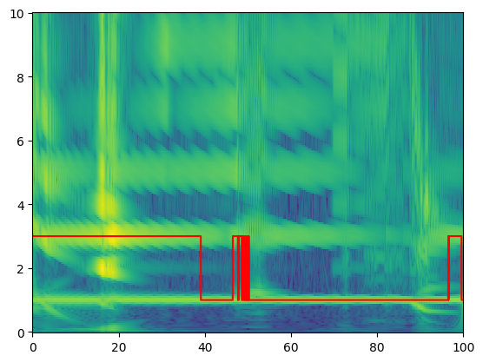
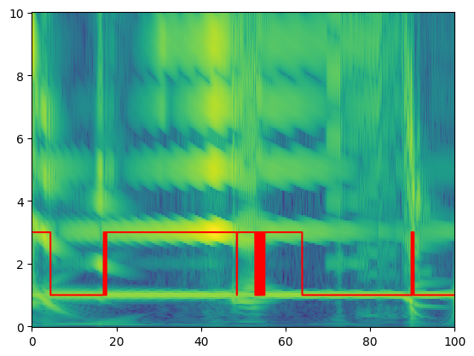
Scaled scalogram
X₁
X₂
X₃

Slide 5
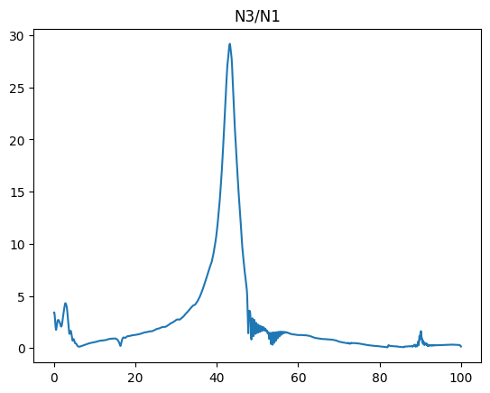

Discriminating threshold in datatraining
$$n_{i}=\frac{1}{2∈}\int_{i−∈}^{i+∈}{amplitude(f) df}$$

Slide 6

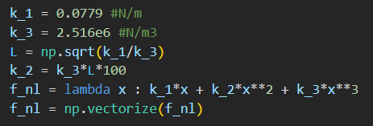

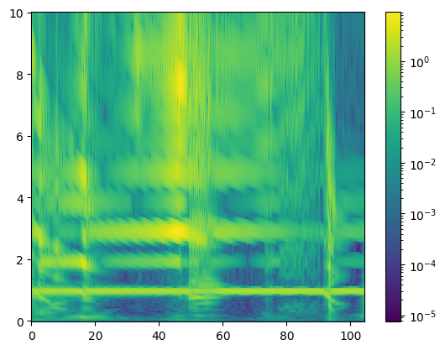
Increase amplitude of even harmonics

